Slide 1

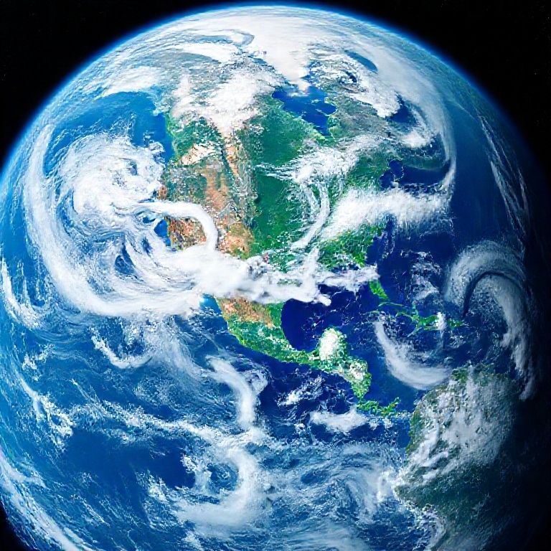
The Blue Marble: Our Home Planet
Earth is the third planet from the Sun and the only astronomical object known to harbor life.
Often called the 'Blue Planet' due to the abundance of liquid water on its surface.
It is a unique and dynamic world, constantly changing due to geological and atmospheric processes.
Formed approximately 4.54 billion years ago, it's a rocky, terrestrial planet.

Slide 2
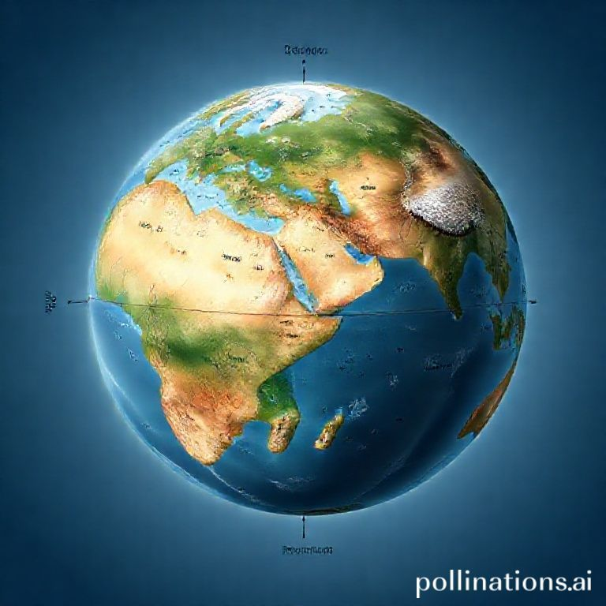
Physical Characteristics: Size and Shape
• Earth is an oblate spheroid, meaning it bulges at the equator and is flattened at the poles.
• It has an average radius of about 6,371 kilometers (3,959 miles).
• Surface is approximately 71% covered by water (oceans, lakes, rivers) and 29% by land (continents and islands).
• It is the fifth-largest planet in our solar system by diameter and mass.

Slide 3
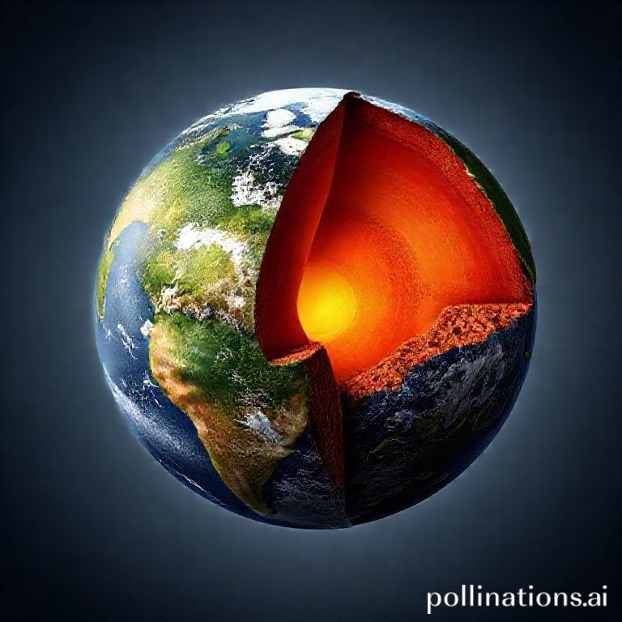
Internal Structure: Layers of Earth
• Earth consists of several distinct layers: the crust, mantle, outer core, and inner core.
• The crust is the thin, solid outer layer where we live, varying in thickness.
• Below the crust is the mantle, a thick layer of hot, semi-solid rock that flows slowly.
• The outer core is liquid iron and nickel, generating Earth's magnetic field.
• The inner core is a solid sphere of iron and nickel, under immense pressure and heat.

Slide 4
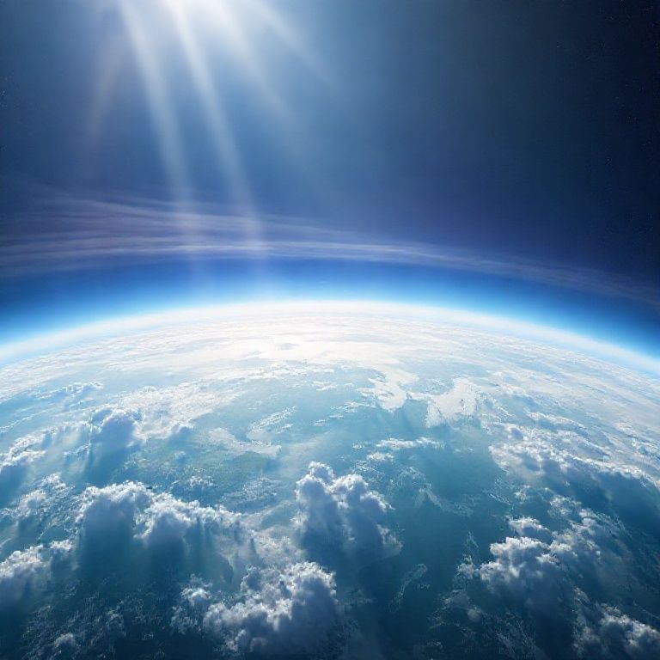
Atmosphere and Climate: The Blanket of Life
• Earth's atmosphere is a protective layer of gases, primarily nitrogen (78%) and oxygen (21%).
• This atmosphere shields life from harmful solar radiation and regulates surface temperature.
• It is responsible for weather phenomena, including winds, clouds, and precipitation.
• The greenhouse effect, largely due to atmospheric gases, keeps Earth warm enough to sustain life.

Slide 5
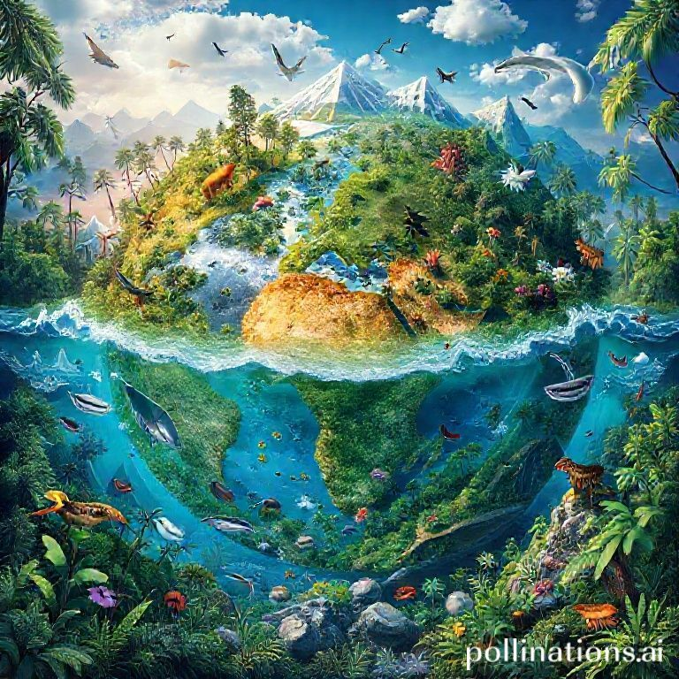
The Cradle of Life: Earth's Uniqueness
• Earth is the only known planet to possess liquid water on its surface, crucial for life.
• Its ideal distance from the Sun (Goldilocks Zone) allows for moderate temperatures.
• A stable atmosphere, magnetic field, and geological activity create a dynamic and habitable environment.
• Home to an incredible diversity of life forms, from microscopic organisms to complex ecosystems.
• Understanding and preserving Earth's delicate balance is vital for the future of all species, including humans.

